Slide 1
Conversational pragmatics and their influences on the interpretation of experimental results
Adam Harris
September 28th, 2017

Slide 2
https://www.youtube.com/watch?v=G0ZZJXw4MTA

Slide 3
Conversational pragmatics: Beyond the literal utterance
How is your family?
Fairly healthy thank you
How is your mother?
Not too good, I’m afraid
How is your family?
Extremely healthy thank you

Slide 4
Conversational pragmatics

Slide 5
Grice (1975)
The cooperative principle.
To expediate communication. Achieved via 4 maxims:
Quality
Quantity
Relation
Manner

Slide 6
Grice (1975)
Quality
Do not say what you believe to be false.
Do not say that for which you lack adequate evidence
Quantity
Make your contribution as informative as required
Do not make your contribution more informative than is required
Relation
Make your contributions relevant
Manner
Avoid obscurity
Avoid ambiguity
Be brief
Be orderly
Nature of the experimental setting:
Even greater expectation for experimenter to be a cooperative conversational partner
[as cited in Hilton (1995)]
Notes:
Highlight: Experimental setting, little scope for clarification. Participant will expect experimenter to be a cooperative conversational partner. Think also about Millgram: Some authority to experimenter, so might be fair to expect it even more…

Slide 7
Reference letters
James is applying to read mathematics at university
James’ maths teacher: “James is always punctual and polite.”
?
Quantity
Make your contribution as informative as required
Under the assumption of a cooperative speaker who has access to more information about James, and is motivated to include it (in this context!), inference is that the referee is trying to communicate information without writing it down.
X

Slide 8
Consider…
What if the reference had been written by James’ tutor who only sees James once a term to discuss any problems he has?
Under the assumption of a cooperative speaker who has access to more information about James, and is motivated to include it (in this context!), inference is that the referee is trying to communicate information without writing it down.
Participants’ inferences are sensitive to different potential attributions of the lack of additional information:
Notes:
But consider the very same reference, given to James by his personal tutor who only saw him once a term, and who does not teach him maths…
…the reference doesn’t seem so damning now – why is this? Presumably, its because the tutor does not have access to the information about James’ maths ability that his maths teacher does – and so the absence of positive information about his maths ability doesn’t make us want to infer that he is in fact bad at maths – rather, the silence is at best uninformative.

Slide 9
UCAS APPLICATION Personal Details
Surname: Driver
Forename(s): James Adrian
Date of Birth: 15/03/1988
Address: 22, Collins Rd,
Sheffield,
S5 8EJ.
Course Applied For: Mathematics
Universities Applied To: Aberdeen
Birmingham
Leeds
Newcastle
Portsmouth
GCSE results: 2 A*s, 2 As, 4 Bs, 2 Cs
_____________________________________________________
Do you think James should be offered a place to read mathematics at Newcastle University? Please circle a number on the scale below:
0 5 10 15 20 25 30 35 40 45 50 55 60 65 70 75 80 85 90 95 100
Never Undecided Definitely
Notes:
The contrasts I’ve already spelled out were placed into the context of an application to a British university. IMPORTANT: EXPLAIN WHAT A UCAS FORM IS AND WHAT GCSEs ARE

Slide 10
UCAS APPLICATION Referee’s Section
Name of Applicant:……James Driver………………………….. Course applied for:…………Mathematics……………………. Name of Referee:………David Rogers BSc……………………. Referee’s Position:……A-level mathematics teacher…………… How does the referee know the applicant?......I have taught James maths throughout his AS and A-level course................
Please write your reference for the aforementioned applicant in the box below,
using no more than 100 words.
Having taught James mathematics throughout his AS and A-level years, I would say the following: James is a polite and punctual pupil.
In light of this new information, do you think James should be offered a place to read mathematics at Newcastle University? Please circle a number on the scale below:
0 5 10 15 20 25 30 35 40 45 50 55 60 65 70 75 80 85 90 95 100
Never Undecided Definitely
Notes:
So participants in this group read a weak argument from an expert source…and were asked to indicate whether they thought James should be offered a place at Newcastle Uni in light of this new information…this condition is where we would expect the faint praise effect to be present…

Slide 11
UCAS APPLICATION Referee’s Section
Name of Applicant:……James Driver………………………….. Course applied for:…………Mathematics……………………. Name of Referee:………David Rogers BSc……………………. Referee’s Position:……History teacher………………………… How does the referee know the applicant?...... I am James’ tutor. We meet once a term to discuss any concerns James has................
Please write your reference for the aforementioned applicant in the box below,
using no more than 100 words.
Having met with James once a term to discuss any concerns he might have, I would say the following: James is a polite and punctual pupil.
In light of this new information, do you think James should be offered a place to read mathematics at Newcastle University? Please circle a number on the scale below:
0 5 10 15 20 25 30 35 40 45 50 55 60 65 70 75 80 85 90 95 100
Never Undecided Definitely
Notes:
In this condition, participants read the same weak argument from James’ tutor, a history teacher, who only saw him once a term…so here we didn’t expect the weak argument to be interpreted as faint praise…

Slide 12
Should James be admitted to Newcastle University?
*
Change induced by weak argument
*
Type of reference
SOURCE p <.05
Harris, Corner & Hahn (2013, T&R)

Slide 13
Conversational pragmatics and reasoning
Experimental task
Inference on the task information
Output judgment
Inference about experimenter’s intended meaning

Slide 14
Conversational pragmatics and reasoning
Experimental task
Inference about experimenter’s intended meaning
Inference on the basis of that meaning
Output judgment
Thus, some ‘faulty’ reasoning might be appropriate reasoning on a different/pragmatic understanding of the task
More discussion of this
(e.g., Lee, 2006)
Adapted from Hilton (1995, Fig. 2)

Slide 15
Gricean pragmatics in action

Slide 16
Linda
Linda is 31 years old, single, outspoken and very bright. She majored in philosophy. As a student, she was deeply concerned with issues of discrimination and social justice, and also participated in anti-nuclear demonstrations.
Which of these two alternatives is more probable?
Linda is a Bank Teller?
Linda is a Bank Teller and is active in the feminist movement.
85%

Slide 17
Linda
Linda is 31 years old, single, outspoken and very bright. She majored in philosophy. As a student, she was deeply concerned with issues of discrimination and social justice, and also participated in anti-nuclear demonstrations.
Which of these two alternatives is more probable?
Linda is a Bank Teller?
Linda is a Bank Teller and is active in the feminist movement.
-------------------------------------------------------------------------------------------------
Quantity maxim
Make your contribution as informative as required
Do not make your contribution more informative than is required
Relation maxim
Make your contributions relevant
85%

Slide 18
Linda
Linda is 31 years old, single, outspoken and very bright. She majored in philosophy. As a student, she was deeply concerned with issues of discrimination and social justice, and also participated in anti-nuclear demonstrations.
Which of these two alternatives is more probable?
Linda is a Bank Teller?
Linda is a Bank Teller and is active in the feminist movement.
-------------------------------------------------------------------------------------------------
Initial ‘blurb’ completely irrelevant to answering the question. Why is experimenter including it?
Must mean something different by ‘probability’ (e.g., a non-mathematical meaning such as possibility)
Hertwig & Gigerenzer (1999, JBDM)
85%

Slide 19
Preserving the maxim of quantity
Linda is 31 years old, single, outspoken and very bright. She majored in philosophy. As a student, she was deeply concerned with issues of discrimination and social justice, and also participated in anti-nuclear demonstrations.
Rate the correspondence between Linda and your idea/images of the categories
Linda is an active feminist
Linda is a bank teller
Linda is a bank teller and an active feminist
Which of the following statements is most probable?
Conjunction fallacy violations decreased from 88% to 59%
-------------------------------------------------------------------------------------------------
Hertwig & Gigerenzer (1999, JBDM)

Slide 20
Asian Disease Problem (T&K, 1981)

Slide 21
Asian Disease Problem (T&K, 1981)
Imagine the USA is preparing for an outbreak of an unusual Asian disease, which is expected to kill 600 people. Two alternative programmes to combat the disease have been proposed. Assume that the exact scientific estimates of the consequences of the programme are as follows:
If Programme A is adopted, 200 people will be saved
If Programme B is adopted, there is a 1/3 probability that 600 people will be saved and a 2/3 probability that no people will be saved.

Slide 22
Asian Disease Problem (T&K, 1981)
Imagine the USA is preparing for an outbreak of an unusual Asian disease, which is expected to kill 600 people. Two alternative programmes to combat the disease have been proposed. Assume that the exact scientific estimates of the consequences of the programme are as follows:
If Programme C is adopted, 400 people will die
If Programme D is adopted, there is a 1/3 probability that nobody will die and a 2/3 probability that 600 people will die

Slide 23
Asian Disease Problem (T&K, 1981)
600 people expected to be killed by rare disease
A: 200 people will be saved
B: 1/3 chance that 600 will be saved; 2/3 chance 0 saved
600 people expected to be killed by rare disease
A: 400 people will die
B: 1/3 chance nobody dies; 2/3 chance 600 people die
(72%)
(78%)
Tversky & Kahneman (1981)

Slide 24
Pragmatic implicatures…

Slide 25
Asian Disease Problem (T&K, 1981)
600 people expected to be killed by rare disease
A: (at least) 200 people will be saved
B: 1/3 chance that 600 will be saved; 2/3 chance 0 saved
600 people expected to die from disease
A: (at least) 400 people will die
B: 1/3 chance nobody dies; 2/3 chance 600 people die
No longer equivalent!
Linguistically, such lower-bound interpretations abound.
Higher values imply lower ones, but not vice versa
If at least 200 people were saved, one or more sets of 200 people were also saved. Not true for at most

Slide 26
Modified ADP (Mandel, 2001; 2014)
To overcome the possible unrealisticness of the precise forecasts in the original
In a war-torn region, the lives of 600 stranded people are at stake. Two response plans with the following outcomes have been proposed. Assume that the estimates provided are accurate
If Plan A is adopted, it is certain that 200 people will be saved.
If Plan B is adopted, there is a one-third probability that all 600 will be saved, and a two-thirds probability that nobody will be saved.
If Plan A is adopted, it is certain that 200 people will die.
If Plan B is adopted, there is a two-thirds probability that all 600 will die and a one-third probability that nobody will die.

Slide 27
Modified ADP (Mandel, 2001; 2014)
To overcome the possible unrealisticness of the precise forecasts in the original
In a war-torn region, the lives of 600 stranded people are at stake. Two response plans with the following outcomes have been proposed. Assume that the estimates provided are accurate
If Plan A is adopted, it is certain that at least 200 people will be saved.
If Plan B is adopted, there is a one-third probability that all 600 will be saved, and a two-thirds probability that nobody will be saved.
If Plan A is adopted, it is certain that at least 200 people will die.
If Plan B is adopted, there is a two-thirds probability that all 600 will die and a one-third probability that nobody will die.

Slide 28
Modified ADP (Mandel, 2001; 2014)
To overcome the possible unrealisticness of the precise forecasts in the original
In a war-torn region, the lives of 600 stranded people are at stake. Two response plans with the following outcomes have been proposed. Assume that the estimates provided are accurate
If Plan A is adopted, it is certain that exactly 200 people will be saved.
If Plan B is adopted, there is a one-third probability that all 600 will be saved, and a two-thirds probability that nobody will be saved.
If Plan A is adopted, it is certain that exactly 200 people will die.
If Plan B is adopted, there is a two-thirds probability that all 600 will die and a one-third probability that nobody will die.

Slide 29
Mandel (2014, JEP:G)
If Plan A is adopted, it is certain that 200 people will be saved.
If Plan B is adopted, there is a one-third probability that all 600 will be saved, and a two-thirds probability that nobody will be saved.
If Plan A is adopted, it is certain that 200 people will die.
If Plan B is adopted, there is a two-thirds probability that all 600 will die and a one-third probability that nobody will die.
57.9%
26.3%
Exactly
59.0%
43.2%
@ least
91.7%
32.5%
Sig. n.s. Sig.
FRAME X MODIFIER INTERACTION
Notes:
Results in line with the hypothesis that a unilateral, at least, interpretation is contributing to framing effects. There was an interaction effect between frame and modifier, but no simple effects test follow-ups. Did the ‘exact’ condition differ from the standard condition?

Slide 30
Conjunction fallacy & risky choice framing
Insights that pragmatic interpretations of the tasks might be different from those originally intended by the experimenter
Experimental testing enables clarification of robustness of the effect (to alternative interpretations), as well as demonstrating the role of conversational pragmatics

Slide 31
Conversational pragmatics and reasoning
Experimental task
Inference about experimenter’s intended meaning
Inference on the basis of that meaning
Output judgment
Thus, some ‘faulty’ reasoning might be appropriate reasoning on a different/pragmatic understanding of the task
More discussion of this
(e.g., Lee, 2006)
Adapted from Hilton (1995, Fig. 2)

Slide 32
Attribute framing & informational leakage
“The operation has an 80% chance of success”
“The operation has a 20% chance of failure”

Slide 33
Attribute framing & informational leakage
“The operation has (at least) an 80% chance of success”
“The operation has (at least) a 20% chance of failure”
More…
c.f. Mandel (2014)

Slide 34
Attribute framing & informational leakage
Quantity maxim
Make your contribution as informative as required
Do not make your contribution more informative than is required
“The operation has an 80% chance of success”
“The operation has a 20% chance of failure”

Slide 35
Tossing a fair coin
H H H T H T H
0
1
2
3
4
5
6
7
Heads
Tails
The coin came up
out of 7 times
76% of descriptions in terms of the majority outcome
Sher & McKenzie (2006, Cognition)

Slide 36
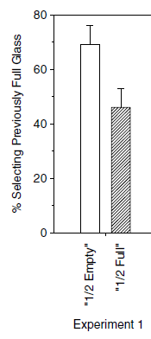
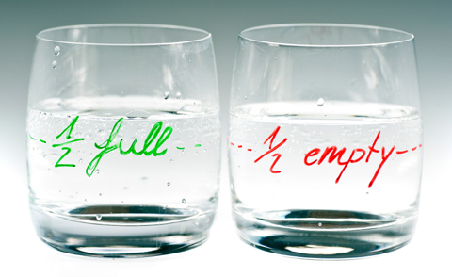
Reference point information
More likely to choose a frame that is above a reference point
=> Can infer reference point from choice of frame
“Please pass me a half-full [empty] glass of water”
Sher & McKenzie (2006, Cognition)
Photo credit: http://quotesgram.com/cup-half-full-quotes/

Slide 37
Attribute framing & informational leakage
Quantity maxim
Make your contribution as informative as required
Do not make your contribution more informative than is required
“The operation has an 80% chance of success”
MORE / BETTER than reference point
“The operation has a 20% chance of failure”
MORE / WORSE than reference point
Beyond reference points…

Slide 38
Implicit recommendations
Reference point hypothesis
Relatively positive things more likely to be described with positive frames
Implicit recommendations
Effect generalises to things viewed as positive, even in the absence of a definitive reference point?

Slide 39
Hiring a team?
Of the last 50 projects undertaken by Team A, 30 were successes.
Of the last 50 projects undertaken by Team B, 20 were failures.
Which would you hire?
Valence-consistent shift
Sher & McKenzie (2006, Expt. 5)
Based on Duchon et al. (1989)

Slide 40
Research & Development Funding
Please imagine a research-and-development project team at an international high-tech firm. This team consists of 18 people…
…30 projects were successes and 20 projects were failures
Three questions from their supervisor who is making funding decisions.
Q2: “What is this team’s track record?”
successes
failures
Of the last 50 projects undertaken by the team, __________ were

Slide 41
Research & Development Funding
…all of whom have PhDs in engineering (Harvard, Princeton and Stanford). Three of the team members have received Nobel Prizes in chemistry and medicine for work related to their current company projects. The team generally undertakes bold and challenging problems – thus most of the team’s failures have been valiant and groundbreaking attempts at seemingly unsolvable problems, while the team’s successes have been truly extraordinary, sometimes revolutionary.
Of the last 50 projects undertaken by the team, 20 have been failures and 30 have been successes. The team has won the Best R&D Team Award from the International Conference of High-Tech Businesses 8 years in a row.

Slide 42
Research & Development Funding
Please imagine a research-and-development project team at an international high-tech firm. This team consists of 18 people…

Slide 43
Research & Development Funding
…only 2 of whom have undergraduate degrees (one from a community college which is no longer in existence). One of the team members is currently working, with difficulty, towards his high school equivalency degree. Two of the team’s members used to have low-level positions in academia, but were forced to resign for falsifying data. The team generally undertakes easy, almost trivial projects – thus most of the team’s failures have been incoherent attempts at simple problems, while the team’s successes have been slightly confused but nonetheless adequate.
Of the last 50 projects undertaken by the team, 20 have been failures and 30 have been successes. Some other researchers in the high-tech industry joke to themselves that if the International Conference of High-Tech Businesses had an award for Worst R&D Team, this team would surely have won it for the last 8 years in a row.

Slide 44
Research & Development Funding
Q2: “What is this team’s track record?”
Bad team: 76% success frame
Good team: 97% success frame
successes
failures
Of the last 50 projects undertaken by the team, __________ were

Slide 45
Hiring a team?
Of the last 50 projects undertaken by Team A, 30 were successes.
Of the last 50 projects undertaken by Team B, 20 were failures.
Which would you hire?
P(Good team | success framing)
P(Good team | failure framing)

Slide 46
Rationality of valence-consistent shift
Bad team: 76% success frame
Good team: 97% success frame
Notes:
Doesn’t matter what the base rate of good and bad teams are, positive frames increase the likelihood that it is a good team.

Slide 47
Rationality of valence-consistent shifts
Because the communicator has choice over the framing of the information, the frame can carry informational value if there is some systematicity in frame usage.
Sher and McKenzie (2006) demonstrate there is.
Choice of frame carries informational value beyond the literal meaning
Different frames are informationally non-equivalent
This information can be used!
Rests on shared understanding of conversational conventions between speaker and listener
Not to say it can’t go wrong!

Slide 48
Beware the psychologist’s fallacy…

Slide 49
The psychologist’s fallacy
Experimental task
Inference about experimenter’s intended meaning
Inference on the basis of that meaning
Output judgment
The great snare of the psychologist is the confusion of his own standpoint with that of the mental fact about which he is making his report. I shall hereafter call this the ‘psychologist’s fallacy’ par excellence.”
(William James, as quoted in Mandel, 2014, p. 1196).
Adapted from Hilton (1995, Fig. 2)

Slide 50
How to overcome?
Thoughts?
Notes:
Situations where dialogue is not between cooperative speakers – e.g., computer program
Example of Filip’s MSc project: Lives saved per £100; % money spent on overheads

Slide 51
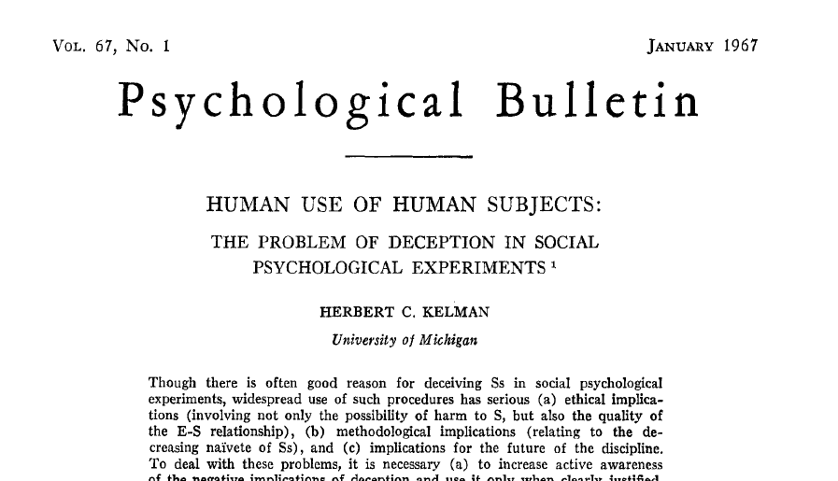
Grice (1975)
Quality
Do not say what you believe to be false.
Do not say that for which you lack adequate evidence
Quantity
Make your contribution as informative as required
Do not make your contribution more informative than is required
Relation
Make your contributions relevant
Manner
Avoid obscurity
Avoid ambiguity
Be brief
Be orderly
Nature of the experimental setting:
Even greater expectation for experimenter to be a cooperative conversational partner
[as cited in Hilton (1995)]
Notes:
Highlight: Experimental setting, little scope for clarification. Participant will expect experimenter to be a cooperative conversational partner. Think also about Millgram: Some authority to experimenter, so might be fair to expect it even more…

Slide 52
Two effects
“You mislead me. It’s getting so I find it difficult to trust you. I’m beginning to see you as a trickster, a manipulator.” (Jourard, 1968, p. 9).
Negative subject
‘Screw you’ effect (Masling, 1966)
Skeptical subject
Experimental evidence (reports of increased suspicion – even at 3 month follow-up!), e.g., Epley & Huff (1998, PSPB)
Modelling (e.g., McKenzie et al., 2004, JEP:LMC)

Slide 53
Negative subject (‘screw you’) effect (Christensen, 1977, JPSP)
‘Construct a sentence with a pronoun and a verb’
Every time a sentence began with ‘we’ or ‘they’, the experimenter replied ‘good’
Taffel verbal conditioning task
By the 5th block of 20 trials:
Following experiment with no deceit | Following an experiment including deceit
≈14 | ≈8
Number of sentences including the pronoun ‘we’ or ‘they’
Notes:
Deceipt was telling participants performance was related to OCD, otherwise a learning expt.
Non-deceit was a learning task.
Subjects included in analysis were aware of the study’s hypothesis

Slide 54
Skeptical subject
A developmental study
Self-control
Other possibilities?
’rational snacking’ (Kidd et al., 2013)

Slide 55
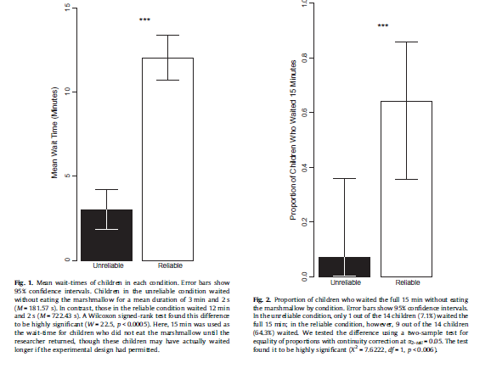
Skeptical subject
A developmental study
Self-control
Other possibilities?
Kidd et al. (2013, Cognition)
Notes:
Means around 3 minutes and 12 minutes
Means around 0.1 and 0.6

Slide 56
Conversational pragmatics and experimentation
An experiment is a social exchange
Similar expectations to real social exchanges
Cooperative principles
Information sources are rarely perfectly reliable
Even if they intend to be, they may be mistaken
What can we do about it?

Slide 57
No deception or receive double your experimental credit or pay
McKenzie & Wixted (2001). Participant skepticism: If you can’t beat it, model it. Behavioral and Brain Sciences, 24, 424-425.

Slide 58
In this study, you will be asked to judge the likelihood that you will win a raffle prize of £20, based on the information that will be provided in two scenarios. A condition of the ethical approval for this project (CPB/2010/010) is that no deception is involved. Thus, the chance of you winning each raffle is accurately represented and that proportion of participants will be paid £20. Proof of such payments will be available upon request and completion of data collection by emailing adam.harris@ucl.ac.uk. If you have any complaints about the study, please first address them to Dr Harris. If you are still dissatisfied, you may contact the head of research ethics for the Division of Psychological & Language Sciences, Prof. Essi Viding (e.viding@ucl.ac.uk). You may print this page for your records.

Slide 59
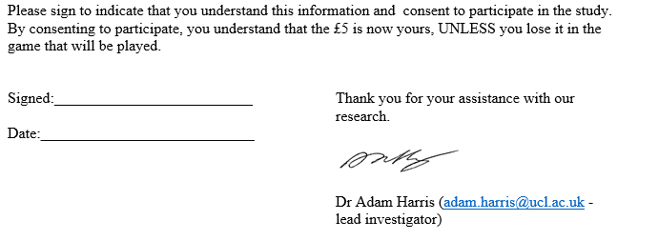

Slide 60
Participant ‘runs’ the experiment
Notes:
Conservatism example
Warwick DM example

Slide 61
Run experiment in an economics lab!

Slide 62
There are some steps we can take
Unreasonable (& inappropriate[?]) for participants to fully trust us
Be aware of potential participant skepticism in interpretations of results
Model trustworthiness?? (e.g.,McKenzie et al., 2004).

Slide 63
Conversational pragmatics and experimentation
An experiment is a social exchange
Similar expectations to real social exchanges
Cooperative principles
Information sources are rarely perfectly reliable
Even if they intend to be, they may be mistaken
Important awareness in design and interpretation of experiments
Related neural activity could be misattributed (by the experimenter)

Slide 64
Beware the psychologist’s fallacy…

Slide 65
The psychologist’s fallacy
Experimental task
Inference about experimenter’s intended meaning
Inference on the basis of that meaning
Output judgment
The great snare of the psychologist is the confusion of his own standpoint with that of the mental fact about which he is making his report. I shall hereafter call this the ‘psychologist’s fallacy’ par excellence.”
(William James, as quoted in Mandel, 2014, p. 1196).
Adapted from Hilton (1995, Fig. 2)

Slide 66
References
Christensen, L. (1977). The negative subject: Myth, reality, or a prior experimental experience effect? Journal of Personality and Social Psychology, 35, 392-400.
Harris, A. J. L., Corner, A., & Hahn, U. (2013). James is polite and punctual (and useless): A Bayesian formalisation of faint praise. Thinking & Reasoning, 19, 414-429.
Hilton, D. J. (1995). The social context of reasoning: Conversational inference and rational judgment. Psychological Bulletin, 118, 248-271.
Kidd, C., Palmeri, H., & Aslin, ,R. N. (2013). Rational snacking: Young children’s decision-making on the marshmallow task is moderated by beliefs about environmental reliability. Cognition, 126, 109-114.
Lee, C. J. (2006). Gricean charity; The Gricean turn in psychology. Philosophy of the Social Sciences, 36, 193-218.
Mandel, D. R. (2014). Do framing effects reveal irrational choice? Journal of Experimental Psychology: General, 143, 1185-1198.
McKenzie, C. R. M. (2004). Framing effects in inference tasks – and why they are normatively defensible. Memory & Cognition, 32, 874-855.
McKenzie, C. R. M., Wixted, J. T., & Noelle, D. C. (2004). Explaining purportedly irrational behavior by modeling skepticism in task parameters: An example examining confidence in forced-choice tasks. Journal of Experimental Psychology: Learning, Memory & Cognition, 30, 947-959.
Sher, S., & McKenzie, C. R. M. (2006). Information leakage from logically equivalent frames. Cognition, 101, 467-494.

